Slide 1
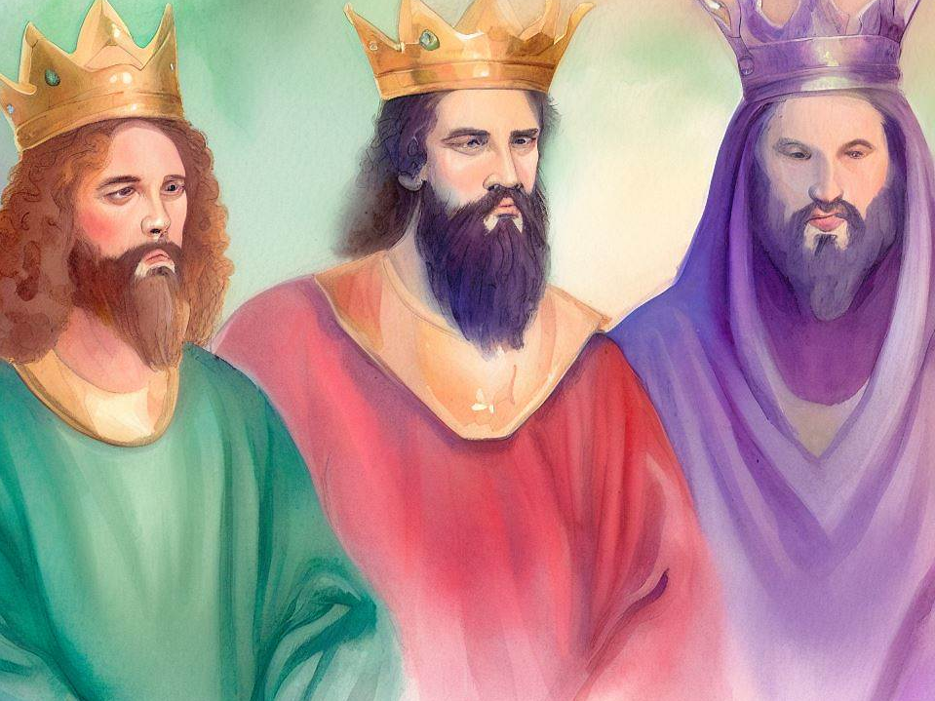
United Kingdom (Part 1)
Quarter 4: Lesson 1 Israel Demands a King

Slide 2



Review: From Creation to the United Kingdom
Genesis: Beginnings
Creation
The beginning of the family (Matthew 19)
Man’s sin and God’s answer (Genesis 3:15)
The Flood -- Man’s sin and God’s judgment
Promises to Abraham (Genesis 12:1-3, 7)
Land, Nation, Seed
12 sons of Jacob → tribes → nation of Israel
Eventual home in Egypt through God’s providence in the life of Joseph

Slide 3
Review: From Creation to the United Kingdom
“You Shall Be My People”
Exodus: Redemption thru Moses
Israel develops as a nation in Egyptian bondage
God delivers Israel from bondage through Moses
Judgment upon Egypt (Genesis 15:13-14)
Mosaic Law at Sinai
Covenant, Law, Tabernacle, Priesthood
God’s faithful provision for Israel
Israel’s unfaithfulness → wilderness wanderings
Notes:
Genesis 15:13-15 Then He said to Abram: "Know certainly that your descendants will be strangers in a land that is not theirs, and will serve them, and they will afflict them four hundred years. 14 And also the nation whom they serve I will judge; afterward they shall come out with great possessions. 15 Now as for you, you shall go to your fathers in peace; you shall be buried at a good old age.

Slide 4
Review: From Creation to the United Kingdom
Invasion and Conquest
Joshua replaces Moses
The Promised Land was conquered. God kept His word faithfully (Joshua 21:44-45).
However, “pockets” of Canaanites were allowed to remain in the land; they would trouble Israel and test its faithfulness (Judges 1:27-36; 2:21-22).
Notes:
Joshua 21:44-45 The LORD gave them rest all around, according to all that He had sworn to their fathers. And not a man of all their enemies stood against them; the LORD delivered all their enemies into their hand. 45 Not a word failed of any good thing which the LORD had spoken to the house of Israel. All came to pass.
Judges 2:21-22 I also will no longer drive out before them any of the nations which Joshua left when he died, 22 so that through them I may test Israel, whether they will keep the ways of the LORD, to walk in them as their fathers kept them, or not."

Slide 5
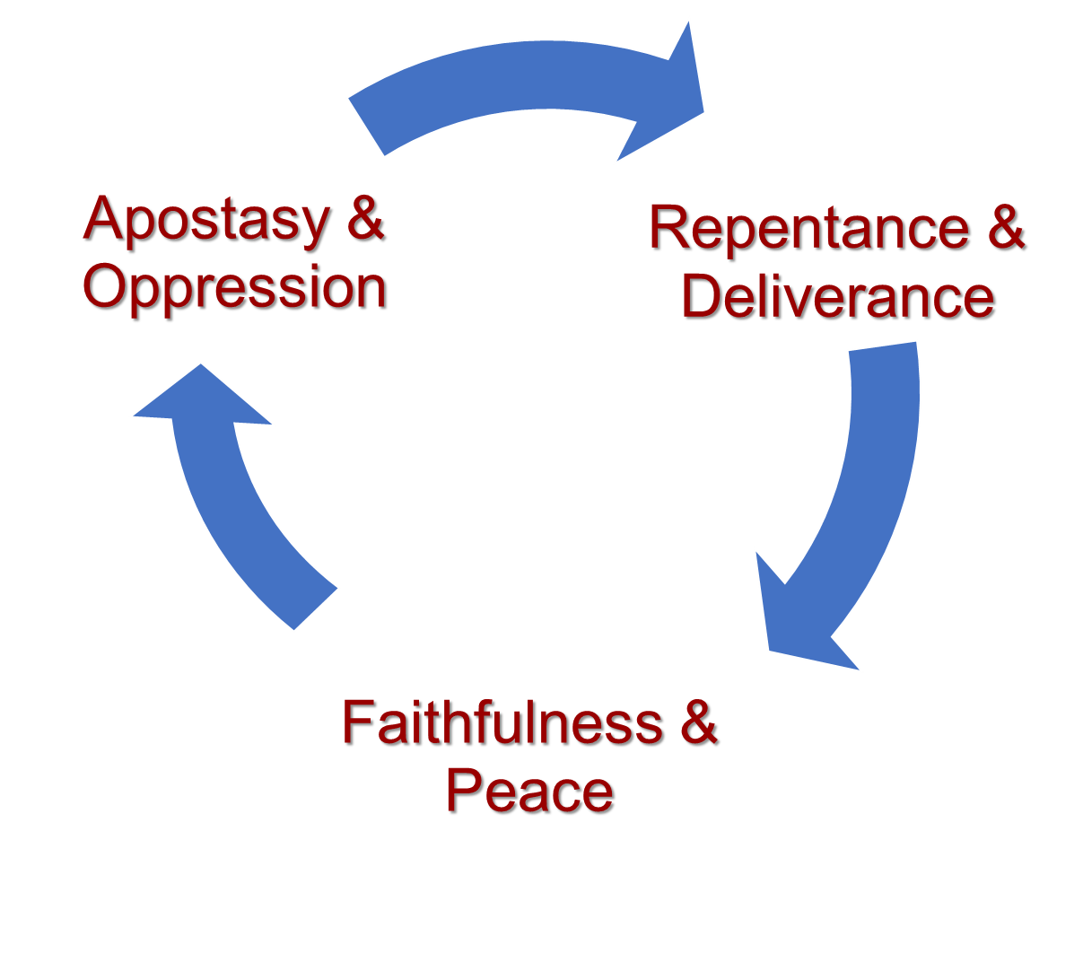
Review: From Creation to the United Kingdom
Invasion and Conquest
In the Days when the Judges Ruled
Repetitive cycle of sin... Israel’s unfaithfulness and God’s mercy (350+ yrs.)
The story of Ruth and Boaz is a bright spot.
Cycle of Sin
Rebellion, Repression, Repentance, Rescue

Slide 6
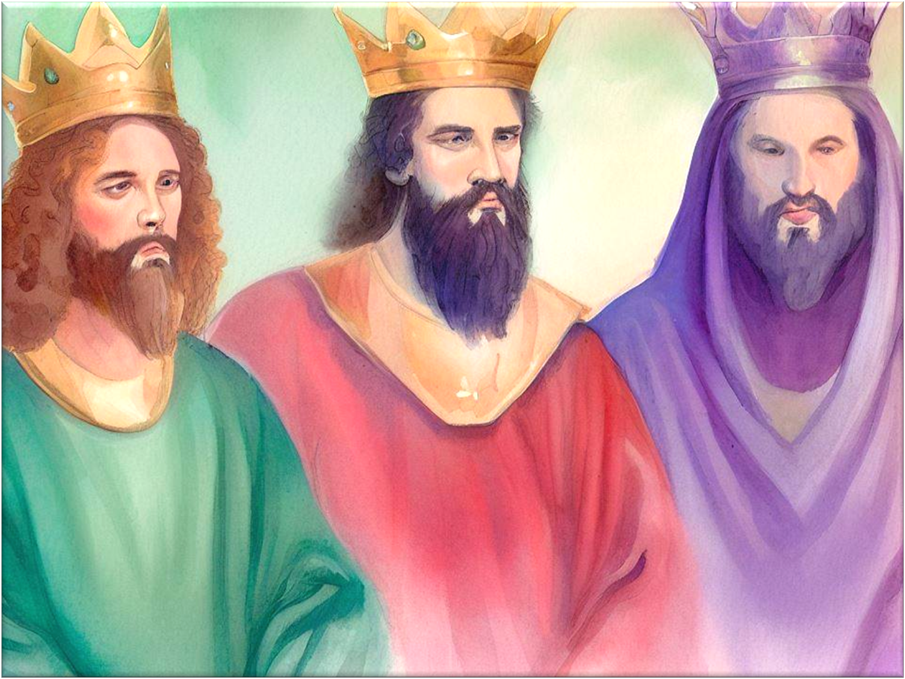
United Kingdom (Part 1)
Our study this quarter introduces the kingdom years when Israel is “united” under one king.
The three kings each reigned 40 years.
– Saul (Acts 13:21)
– David (2 Samuel 5:4)
– Solomon (1 Kings 11:42)
Notes:
Ac 13:21 "And afterward they asked for a king; so God gave them Saul the son of Kish, a man of the tribe of Benjamin, for forty years.
2Sa 5:4 David was thirty years old when he began to reign, and he reigned forty years.
1Ki 11:42 And the period that Solomon reigned in Jerusalem over all Israel was forty years.

Slide 7
United Kingdom (Part 1)
This Quarter We Will Focus On…
Saul as the first king, his undoing, and David’s rise to the throne.
David’s reign and sin with Bathsheba.
We will also examine selected Psalms relating to events that occurred during this time period.

Slide 8
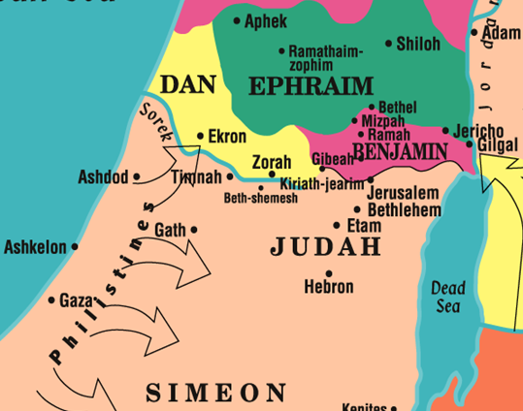
Israel Demands A King 1 Samuel 8:1-22
Historical Context:
The Philistines had again encroached on Israel (1 Samuel 4-5).
The Ark of the Covenant returned to Israel, and the Philistines were subdued. The Lord’s hand was against them the remaining days of Samuel (1 Samuel 7:13).

Slide 9
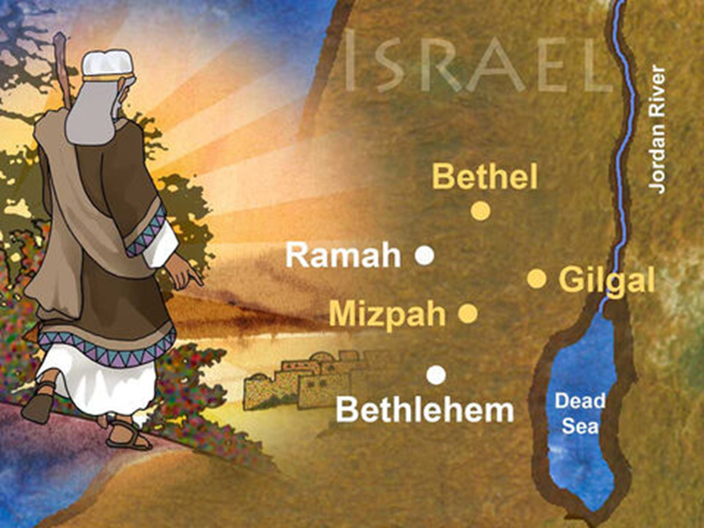
Beersheba

Slide 10
Israel Demands A King 1 Samuel 8:1-22
A Leadership vacuum in Israel?
Samuel is old…HE appointed his sons as judges over Israel in Beersheba (8:1-2).
Compare to Judges 2:16-18; 3:9, 15. Judgeship was not “hereditary.”
His sons did not walk as he did (8:3)
Reminiscent of Eli (1 Samuel 2:12-17, 22).
Had Samuel failed like Eli?
Notes:
Judges 2:16-18 Nevertheless, the LORD raised up judges who delivered them out of the hand of those who plundered them. 17 Yet they would not listen to their judges, but they played the harlot with other gods, and bowed down to them. They turned quickly from the way in which their fathers walked, in obeying the commandments of the LORD; they did not do so. 18 And when the LORD raised up judges for them, the LORD was with the judge and delivered them out of the hand of their enemies all the days of the judge; for the LORD was moved to pity by their groaning because of those who oppressed them and harassed them.
Judges 3:9 When the children of Israel cried out to the LORD, the LORD raised up a deliverer for the children of Israel, who delivered them: Othniel the son of Kenaz, Caleb's younger brother.
Judges 3:15 But when the children of Israel cried out to the LORD, the LORD raised up a deliverer for them: Ehud the son of Gera, the Benjamite, a left-handed man. By him the children of Israel sent tribute to Eglon king of Moab.

Slide 11
Israel Demands A King 1 Samuel 8:1-22
A Leadership vacuum in Israel?
Israel’s concerns (8:4-5).
Samuel had grown old.
His sons did not do as he had done.
Israel’s conclusion: “Appoint for us a king to judge us like all the nations” (ESV).
Samuel’s response: Displeasure and prayer (8:6)
God’s response to Samuel (8:7-9).
They have not rejected you but Me!
Appoint them a king.
Warn them of the behavior of a king.

Slide 12
Israel Demands A King 1 Samuel 8:1-22
Samuel’s Warning (8:10-18)
A king would siphon wealth and manpower from their families.
This warning is similar to the one Moses gave (Deut. 17:14-20).
God would not hear their cry when their king mistreated and burdened them.
Israel’s insistence (8:19-20)
Israel refused to heed Samuel
They wanted to be like other nations!
The Lord instructs Samuel to heed the voice of the people and give them a king (8:21-22)
Notes:
Deuteronomy 17:14-20 "When you come to the land which the LORD your God is giving you, and possess it and dwell in it, and say, 'I will set a king over me like all the nations that are around me,' 15 you shall surely set a king over you whom the LORD your God chooses; one from among your brethren you shall set as king over you; you may not set a foreigner over you, who is not your brother. 16 But he shall not multiply horses for himself, nor cause the people to return to Egypt to multiply horses, for the LORD has said to you, 'You shall not return that way again.' 17 Neither shall he multiply wives for himself, lest his heart turn away; nor shall he greatly multiply silver and gold for himself. 18 "Also it shall be, when he sits on the throne of his kingdom, that he shall write for himself a copy of this law in a book, from the one before the priests, the Levites. 19 And it shall be with him, and he shall read it all the days of his life, that he may learn to fear the LORD his God and be careful to observe all the words of this law and these statutes, 20 that his heart may not be lifted above his brethren, that he may not turn aside from the commandment to the right hand or to the left, and that he may prolong his days in his kingdom, he and his children in the midst of Israel.
Sound familiar? We want to be like everyone else. Everyone else is doing it. Why do we have to be different???

Slide 13
Applications for Today
Failure of individuals to do right can adversely affect an entire nation -- or church, or family (1 Samuel 18:3-5, cf. Matthew 18:6-7).
God will allow us to suffer the consequences of our own sinful, selfish, or self-willed choices (1 Samuel 8:5, 19-20; Romans 1:24-28; 1 Corinthians 5:4-5).
God’s people are to be separate from the world (1 Samuel 18:5; Leviticus 23:26; Romans 12:2; 2 Corinthians 6:17; 2 Peter 2:9-11).
Notes:
Romans 1:24 Therefore God also gave them up to uncleanness, in the lusts of their hearts, to dishonor their bodies among themselves, 25 who exchanged the truth of God for the lie, and worshiped and served the creature rather than the Creator, who is blessed forever. Amen. 26 For this reason God gave them up to vile passions. For even their women exchanged the natural use for what is against nature. 27 Likewise also the men, leaving the natural use of the woman, burned in their lust for one another, men with men committing what is shameful, and receiving in themselves the penalty of their error which was due. 28 And even as they did not like to retain God in their knowledge, God gave them over to a debased mind, to do those things which are not fitting;
1 Cor 5:4 In the name of our Lord Jesus Christ, when you are gathered together, along with my spirit, with the power of our Lord Jesus Christ, 5 deliver such a one to Satan for the destruction of the flesh, that his spirit may be saved in the day of the Lord Jesus.
Leviticus 20:26 And you shall be holy to Me, for I the LORD am holy, and have separated you from the peoples, that you should be Mine.
1 Peter 2:9-11 But you are a chosen generation, a royal priesthood, a holy nation, His own special people, that you may proclaim the praises of Him who called you out of darkness into His marvelous light; 10 who once were not a people but are now the people of God, who had not obtained mercy but now have obtained mercy. 11 Beloved, I beg you as sojourners and pilgrims, abstain from fleshly lusts which war against the soul,

